Slide 1


Epilepsy Surgery Trends in the United States from 1990 to 2008
David Ouyang

Slide 2

Medically refractory epilepsy is a common, highly morbid disease.
3 Million Americans
Estimated annual price tag of $12.5 billion in direct and indirect costs
Pharmacotherapy is unsuccessful in controlling seizures in 20% to 40% of patients.
Notes:
WHO 1% of the global burden of disease based on disability-adjusted life-years (DALYs)

Slide 3
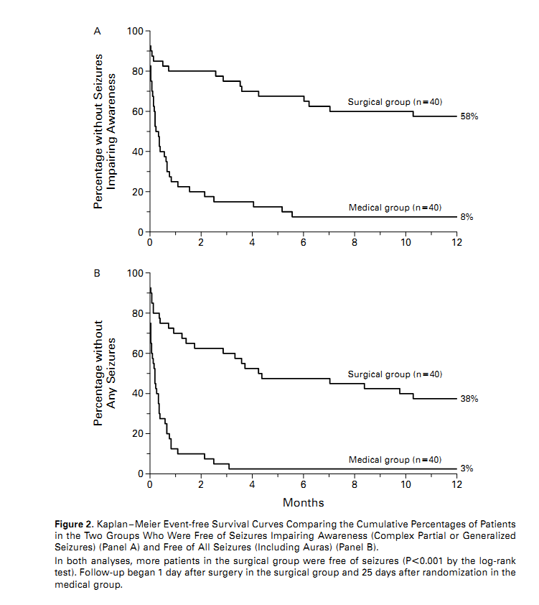
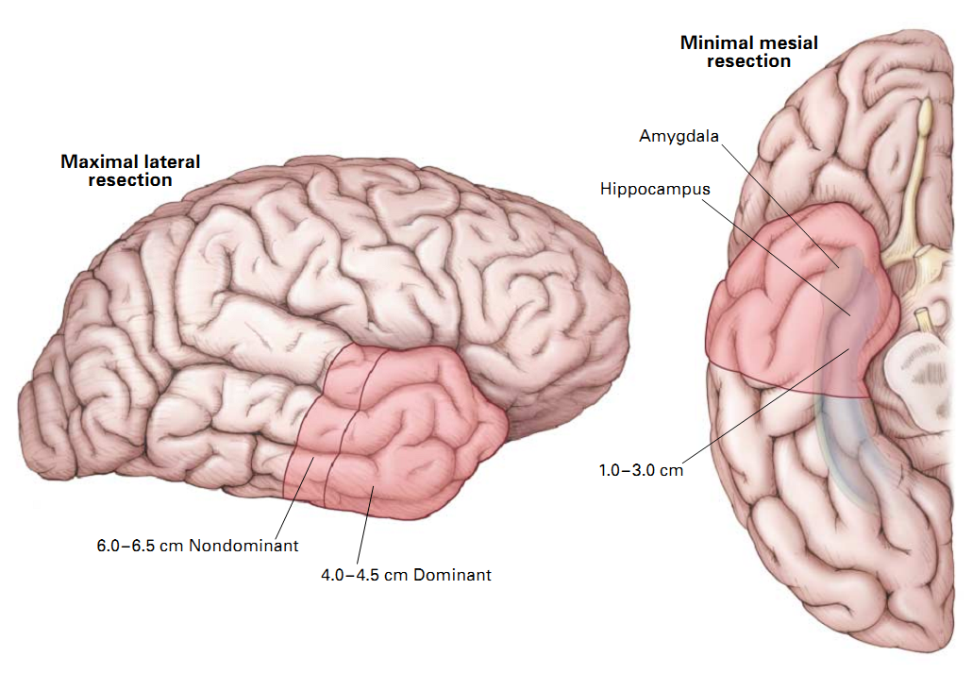
Anterior temporal lobectomy has been validated as a treatment for temporal lobe epilepsy
1.5% of eligible received surgery
Notes:
In 1993, it was estimated 1,500 out of 100,000 eligible surgical candidates received surgery for temporal lobe epilepsy.

Slide 4
Has the use of lobectomy for patients with intractable epilepsy increased in light of class I clinical evidence demonstrating efficacy?
Research Question

Slide 5
The National Inpatient Sample is a 20% stratified sample of inpatient admissions of US hospitals
1990 - 1992
1993- 1997
1998- 2008
2009
Age, Death, Disposition, Diagnoses, Procedures, length of stay, Gender, Race, Payer, Common Comorbidities
Hospital Characteristics
Core Patient File
Severity File
Procedure and Condition Groups
Hospital Name, Address, Bed Size, Teaching Status, Rural/urban, total number of discharges, RN FTEs

Slide 6
Study
Design
simple or complex localized epilepsy (n = 22,133)
Temporal lobectomy (n = 1,326)
No temporal lobectomy (n = 20,807)
863
10,932
1990 - 2001
463
9,875
2002 - 2008
OR = 0.595
P < 0.001

Slide 7
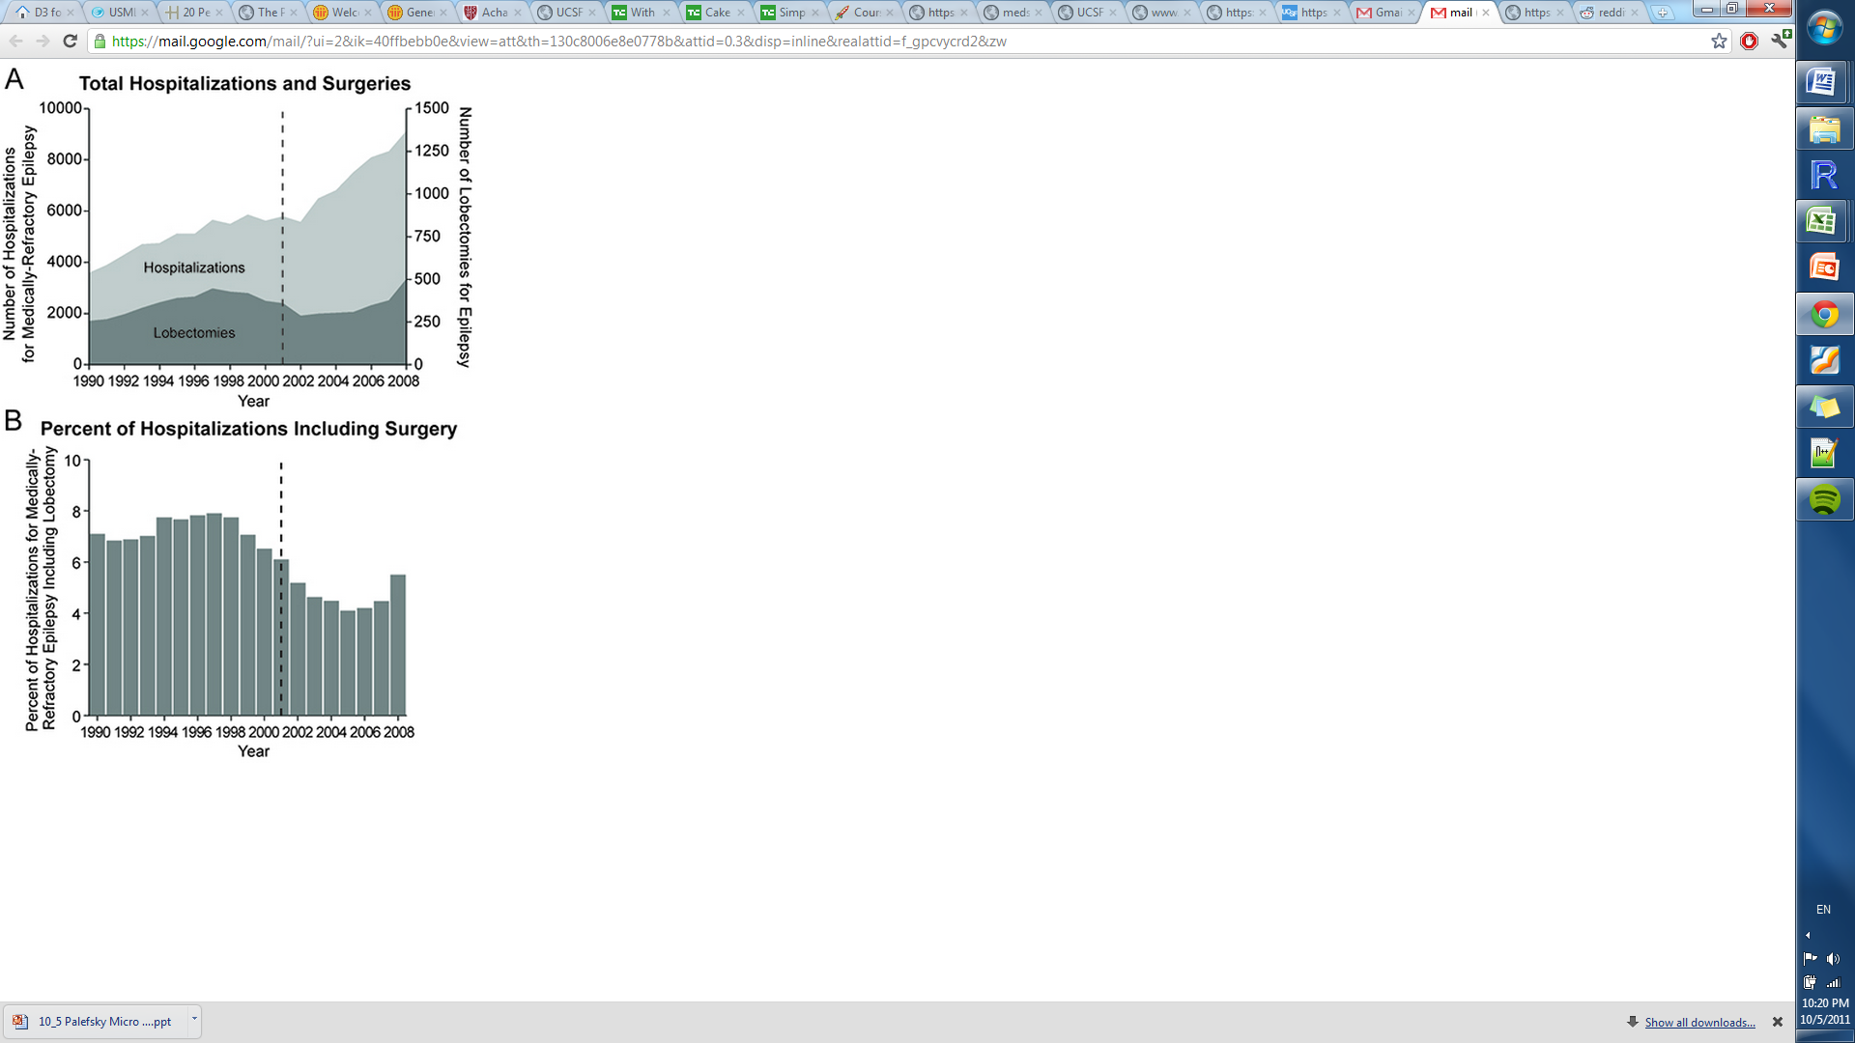
The use of lobectomy for medically intractable epilepsy has not increased between 1990 – 2008.
Results

Slide 8
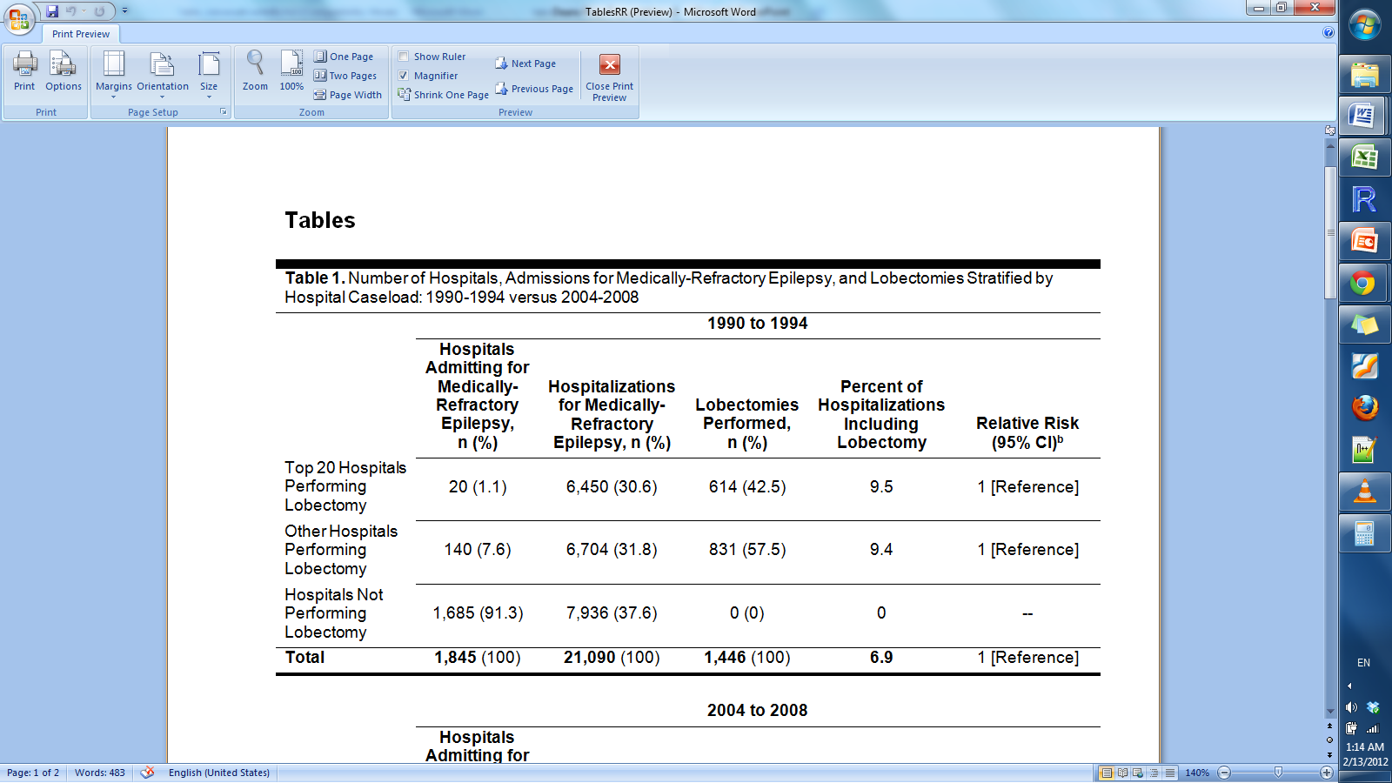
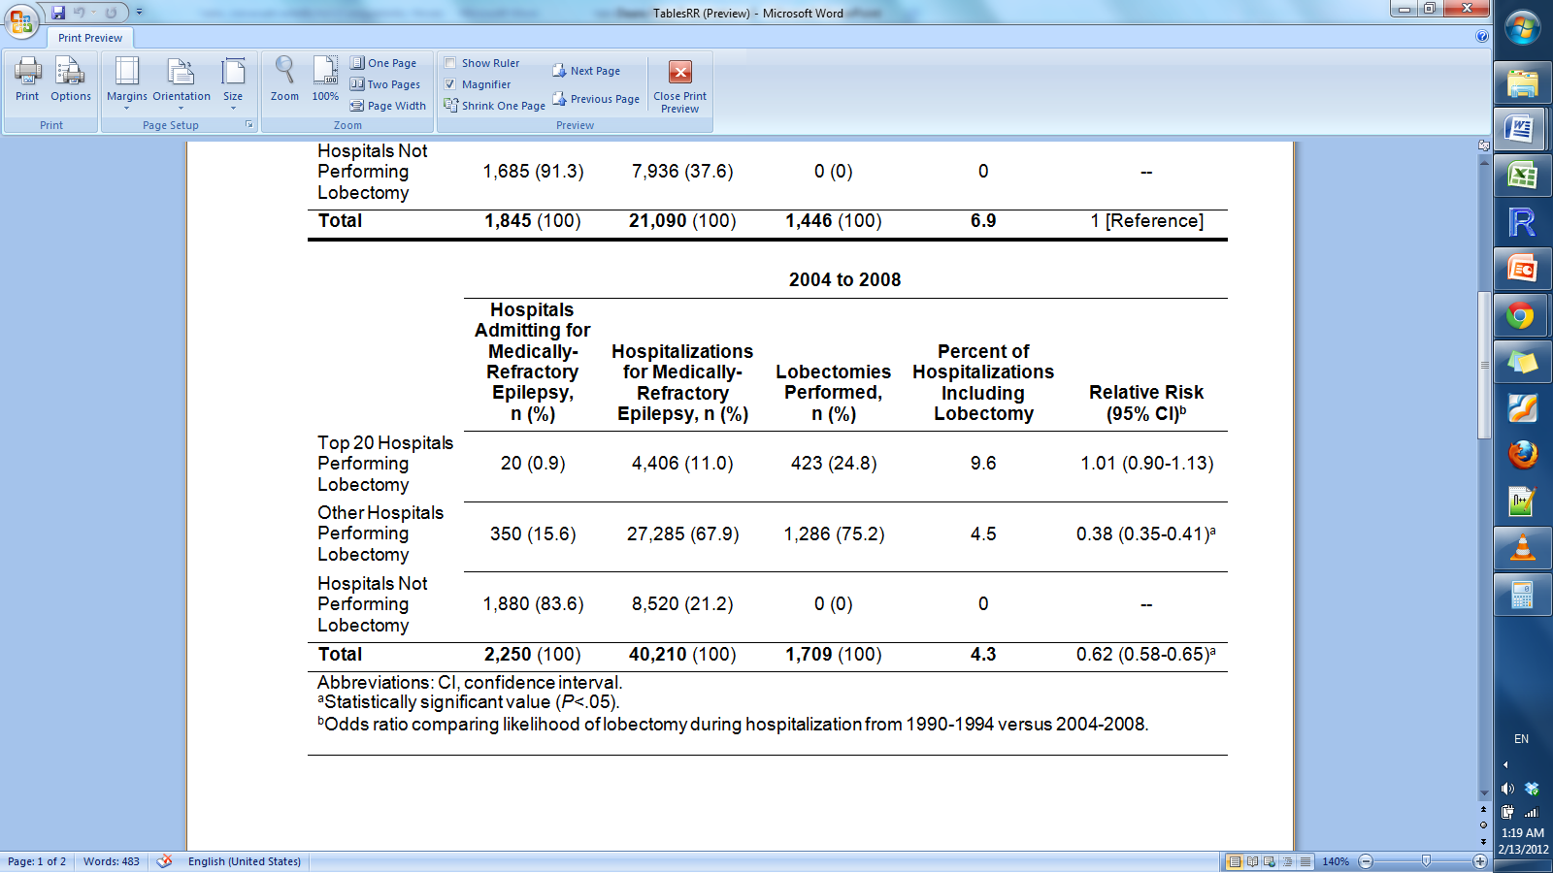
Over time, a greater proportion of medically refractory epilepsy patients are referred to low volume centers
1990 - 1994
2004 - 2008

Slide 9
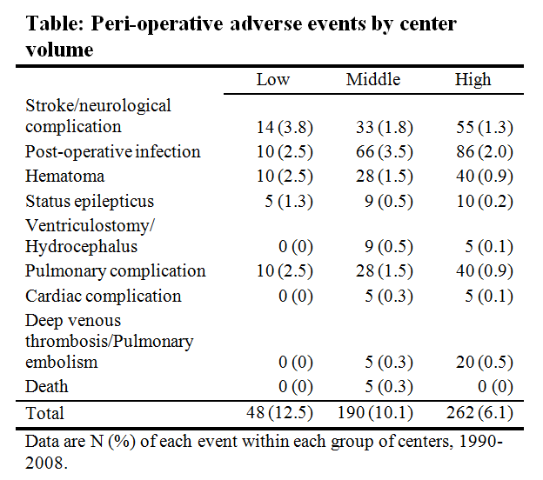
For lobectomy patients, the risk of adverse events increases at low volume centers
X² = 13.6,
p = 0.0002
Notes:
Graph three distributions -5, 5 – 15, 15+

Slide 10
Conclusions
Lobectomy for medically intractable epilepsy is still underutilized, particularly among racial minorities and the underinsured.
Patients with medically refractory epilepsy should be referred to a comprehensive epilepsy center for surgical evaluation by an experienced epilepsy treatment team.

Slide 11
Acknowledgements
Eddie Chang MD
Paul Garcia MD
Dario Englot MD PhD
Doris Wang MD PhD
John Rolston MD PhD

Slide 12
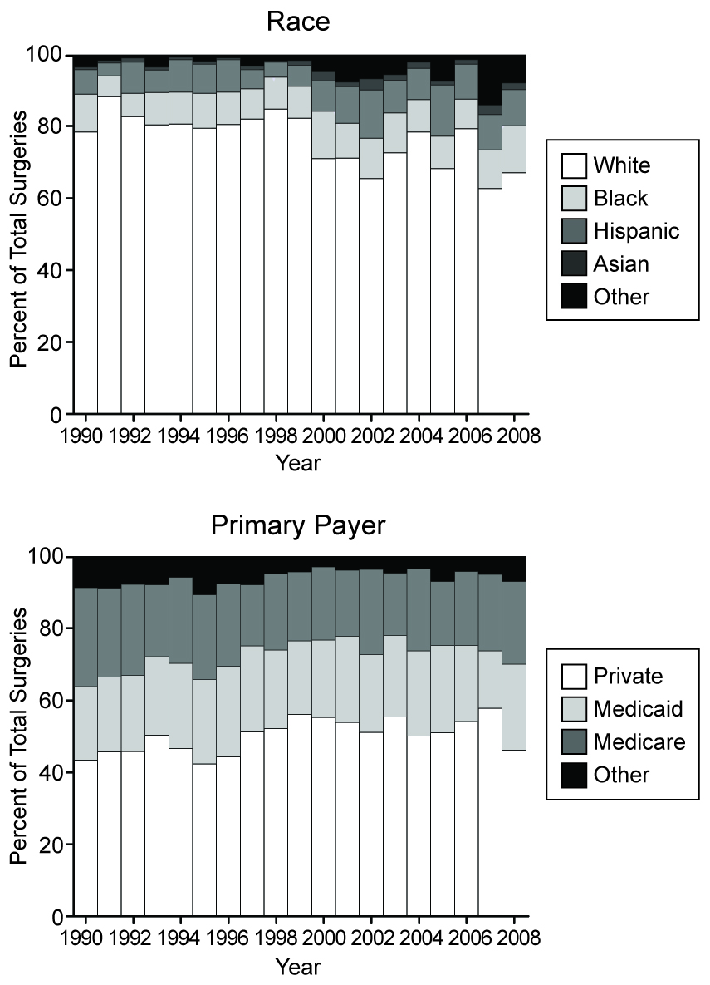
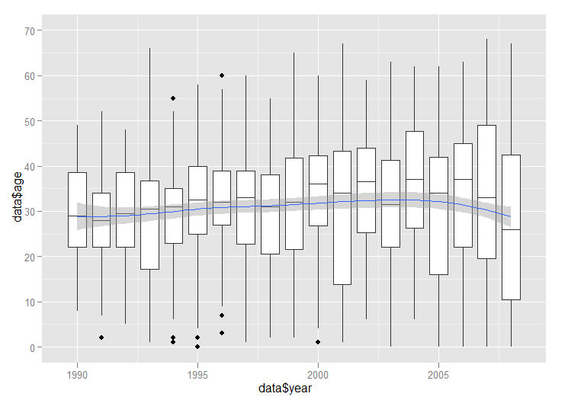
Patient demographics did not change over time
Age
Year

Slide 13
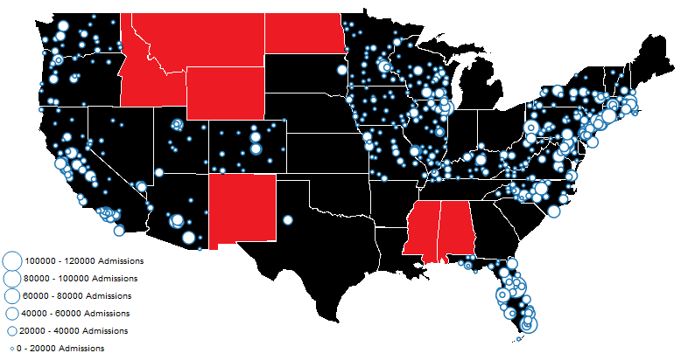
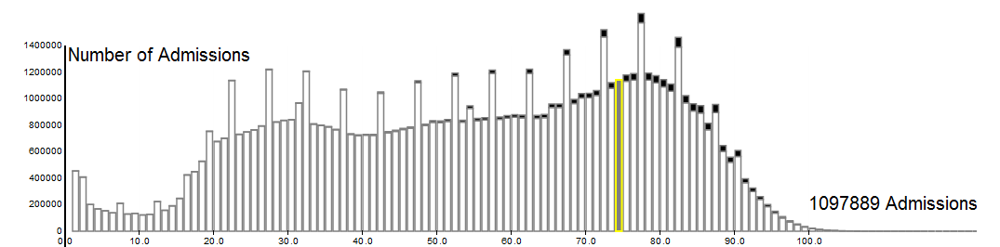
Data was extracted from the National Inpatient Sample non-delimited ASCII files using Python and R.

Slide 14
Proportion of hospitalizations with surgery decreased.

Slide 15
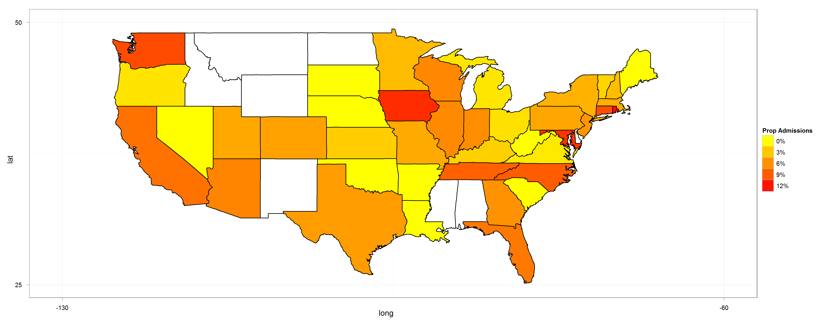

There exists regional, payer, race, and hospital status based disparity in the utilization of lobectomy

Slide 16
Over time, a greater proportion of medically refractory epilepsy patients are referred to low volume centers
1990 - 1994
2004 - 2008

